Slide 1
Optimizers in Deep Learning
Dr. Sifat Momen

Slide 2
Optimizers in Deep Learning
Optimizers in deep learning are algorithms that adjust the model's parameters (weights and biases) to minimize the loss function.

Slide 3
Gradient Descent Variants
Gradient Descent is the foundation of most optimizers.
There are three main types of gradient descent algorithms
Batch Gradient Descent (Also known as gradient descent or vanilla gradient descent): Uses the entire dataset to compute gradients in each step (slow but stable).
Stochastic Gradient Descent (SGD): Updates parameters after each training sample (faster but noisier).
Mini-batch Gradient Descent: Uses a small subset (batch) of data to compute gradients (balance between batch and SGD).

Slide 4
Let us say that we have a dataset of size 500. If we run 10 epochs, how many times the weights will be updated in gradient descent, stochastic gradient descent, and mini-batch (size 30) gradient descent

Slide 5
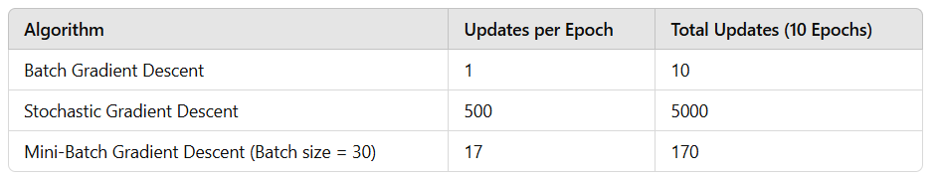
Let us say that we have a dataset of size 500. If we run 10 epochs, how many times the weights will be updated in gradient descent, stochastic gradient descent, and mini-batch (size 30) gradient descent

Slide 6
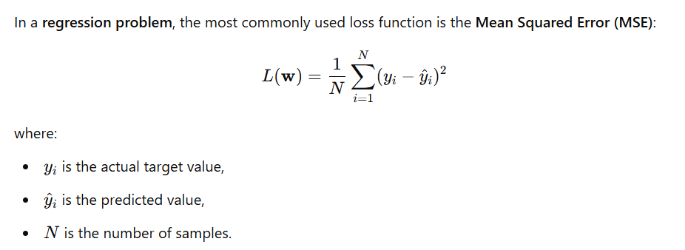
Loss Function for Regression Problem

Slide 7
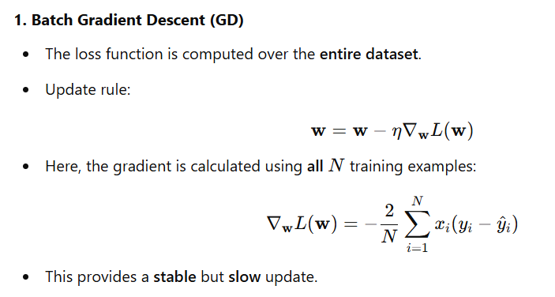
Loss Function for different Gradient Descent Variants

Slide 8
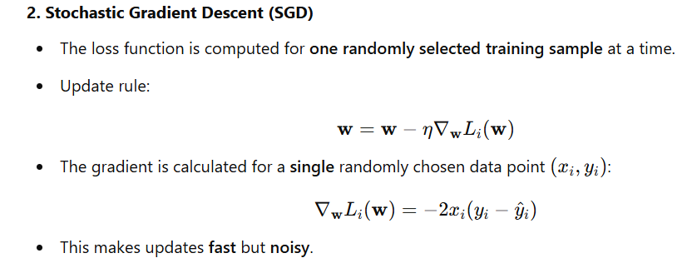
Loss Function for different Gradient Descent Variants

Slide 9
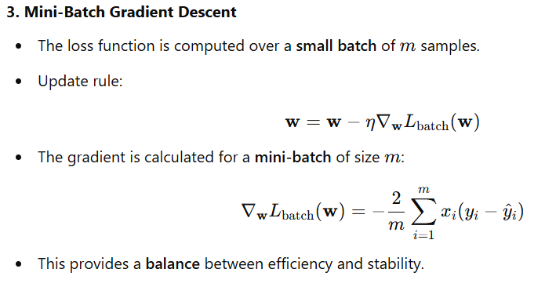
Loss Function for different Gradient Descent Variants

Slide 10
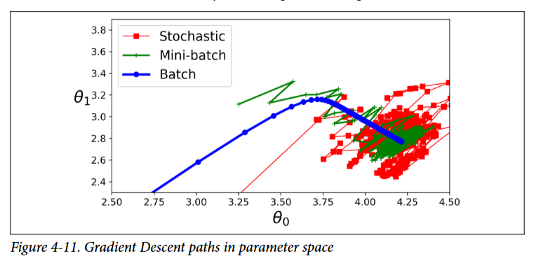
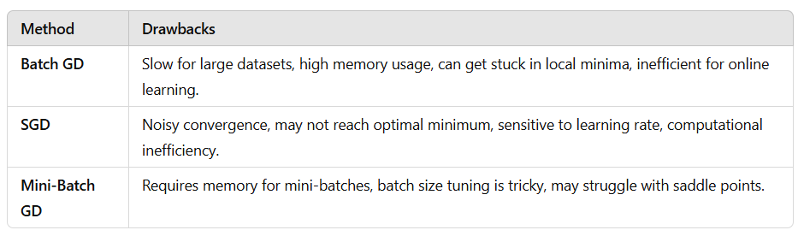
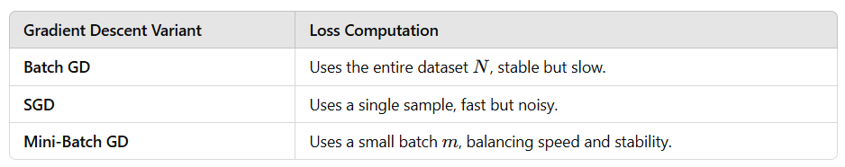
Comparison Summary

Slide 11
Advanced Optimizers
Beyond gradient descent and its variants, deep learning uses more advanced optimizers to improve training speed and stability.
Momentum
Adagrad (Adaptive gradient algorithm)
RMSprop (Root mean square propagation)
Adam (Adaptive moment estimation)

Slide 12

Momentum (SGD with Momentum)
Helps accelerate gradient descent by keeping a moving average of past gradients.
Works like a rolling ball that builds speed in the right direction.

Slide 13
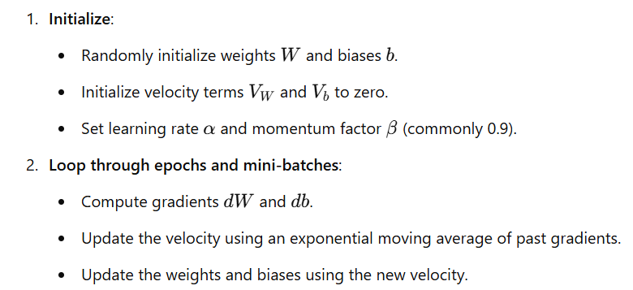
Pseudocode of the Momentum optimizer
# Initialize parameters
initialize weights W and biases b randomly
initialize velocity V_W = 0 and V_b = 0
set learning_rate α
set momentum_factor β # typically 0.9
# Repeat for each iteration (or epoch)
for each epoch:
for each batch in training_data:
# Compute gradients
dW, db = compute_gradients(W, b)
# Update velocity
V_W = β * V_W + (1 - β) * dW
V_b = β * V_b + (1 - β) * db
# Update weights and biases
W = W - α * V_W
b = b - α * V_b

Slide 14
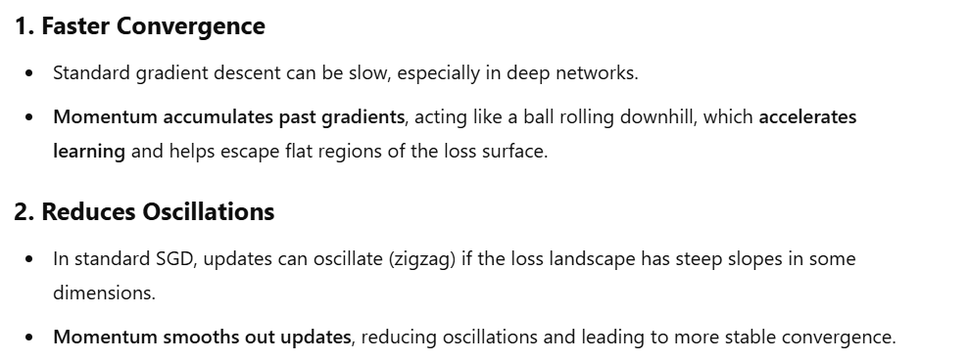
Advantages of Momentum optimizer over standard gradient descent optimizer

Slide 15
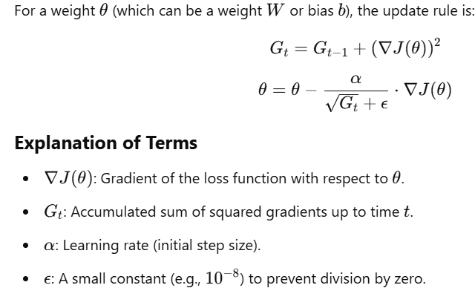
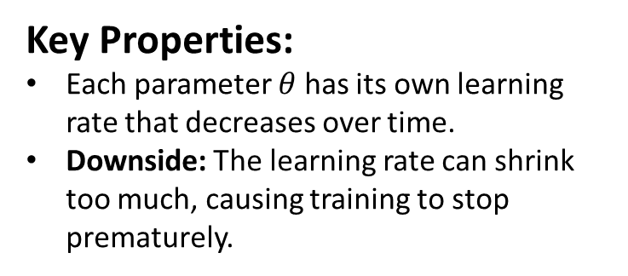
Adagrad (Adaptive gradient algorithm)
The Adagrad optimizer adapts the learning rate for each parameter based on the historical sum of squared gradients.
Key Properties:
Each parameter $θ$ has its own learning rate that decreases over time.
Downside: The learning rate can shrink too much, causing training to stop prematurely.

Slide 16
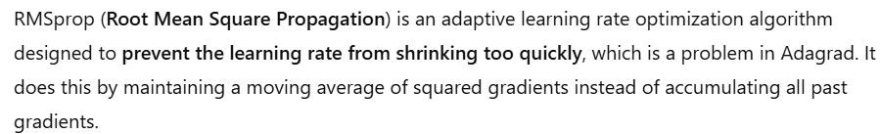
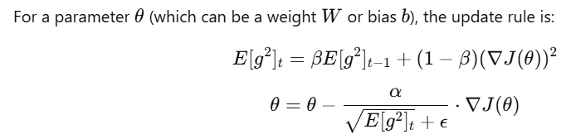
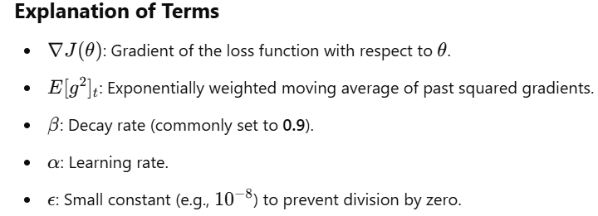
RMSprop

Slide 17
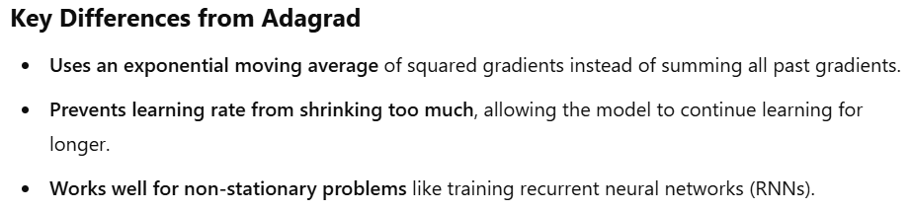
RMSprop

Slide 18
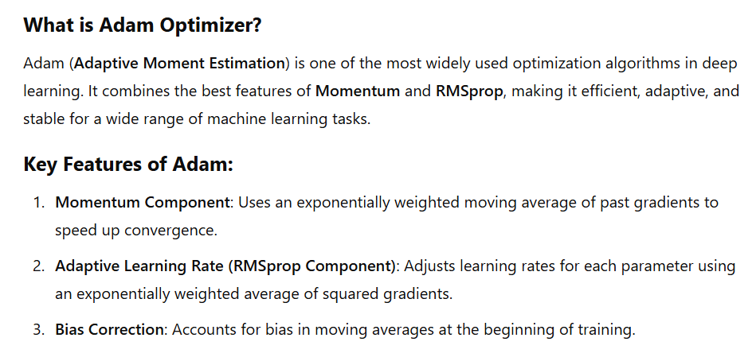
Adam Optimizer (Adaptive Moment Estimation)

Slide 19
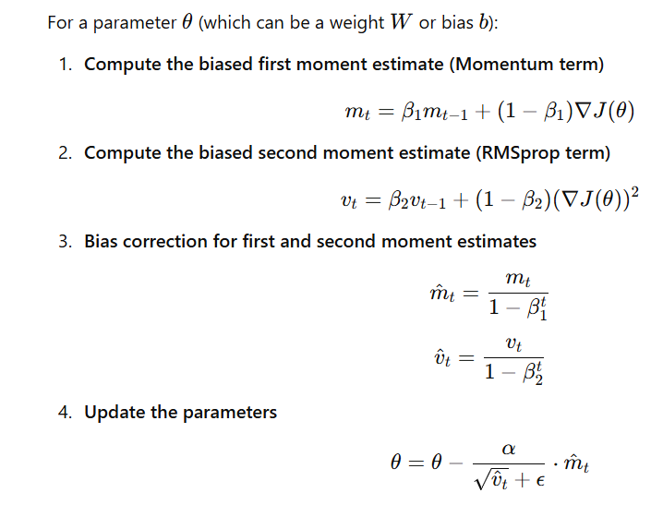
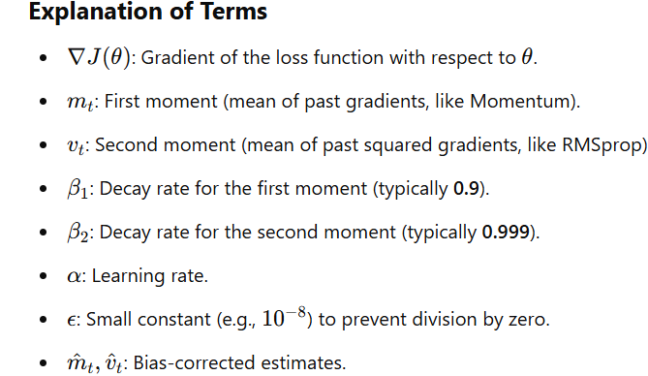
Formula for Adam weight updates

Slide 20
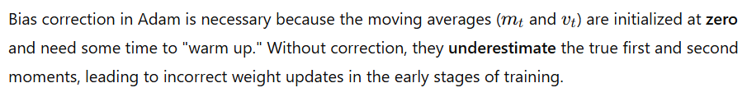
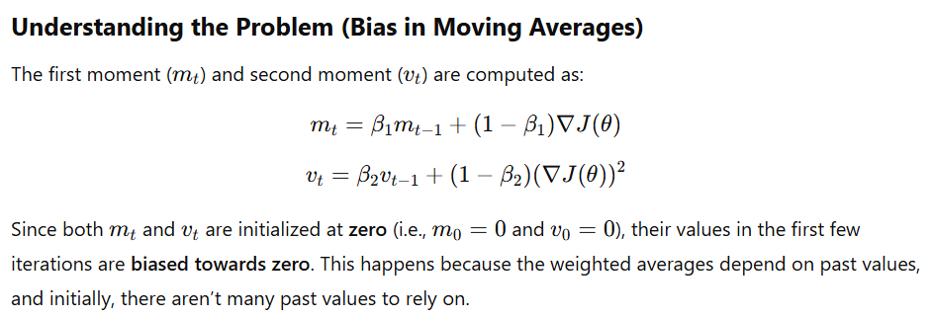
Bias Correction

Slide 21
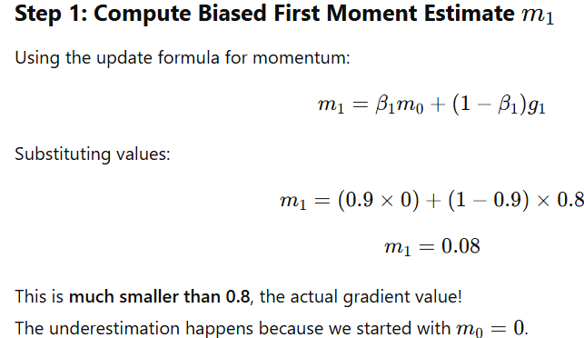
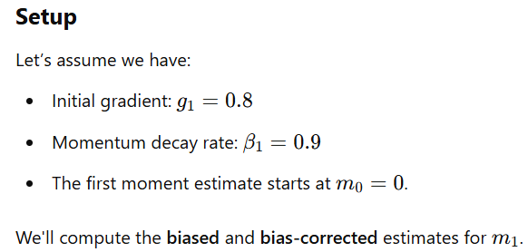
Bias Correction

Slide 22
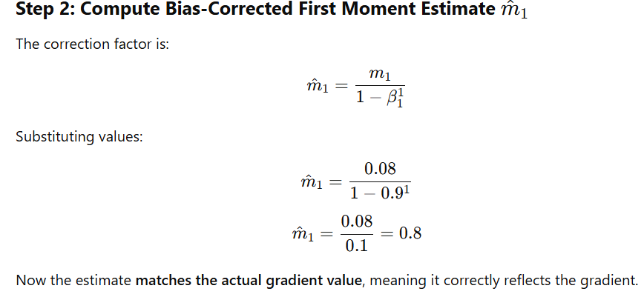
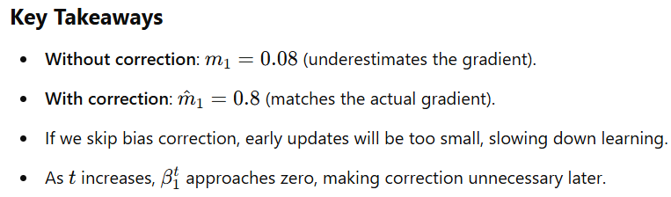
Bias Correction

Slide 23
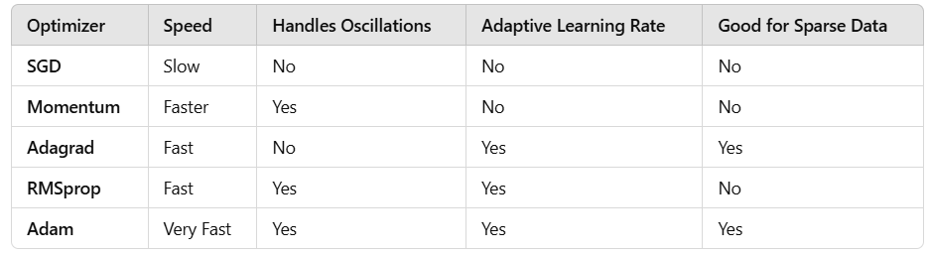
Comparison between optimizers

